Slide 1
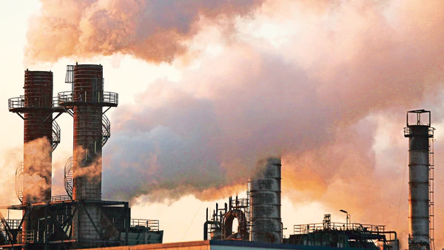
Air Permit: Stationary Sources
By Keifer Kanayurak
Notes:
Air permits were developed under the Clean Air Act to regulate the emission of criteria air pollutants in order to maintain healthy air quality and improved visibility.

Slide 2
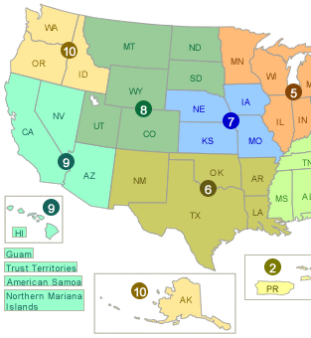
Air Permits
Title-I Permit
Construction permits
Minor source specific
Title-V Operating Permit
New Source Review permits
Prevention of Significant Deterioration (PSD) permit
Nonattainment NSR permit

Slide 3
Title V Applicable
Any major source with actual (or potential) emission levels at (or above) the major source threshold. 100 tons/year
Lower thresholds do apply to areas classified as nonattainment.
Specific thresholds exist for HAPs
I don’t care for asbestos and I don’t care for methyl tertiary butyl ether
Notes:
The lower threshold levels are based on two main factors: (1) source type and (2) severity designation of nonattainment area
Hazardous Air Pollutants (HAP)

Slide 4
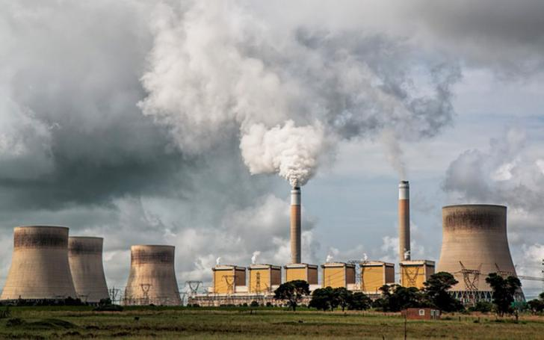
Title V Applicable (continued)
HAP (continued)
Threshold for single pollutant: 10 tons/year
Any combination of multiple pollutants: 25 tons/year
Permits under the New Source Review Program
Prevention of Significant Deterioration (PSD) permit
Attainment or unclassifiable areas
Nonattainment NSR permit
Notes:
NSR :
(PSD) Development of a new major source or modification of an existing major source within area(s) that meet National Ambient Air Quality Standard (NAAQS)
Within attainment of NAAQS or unclassifiable (data does not exist for the area in question)
(Nonattainment) are required for new major source development or modifications to major sources in area(s) that do(es) not meet NAAQS. More stringent than a PSD permit and its purpose is to achieve attainment under the NAAQS.
(Minor) apply to sources or areas that don’t require a PSD permit nor a Nonattainment NSR permit and its purpose is to prevent the need for the above permits (only requires a title V permit if subject to NESHAP).

Slide 5
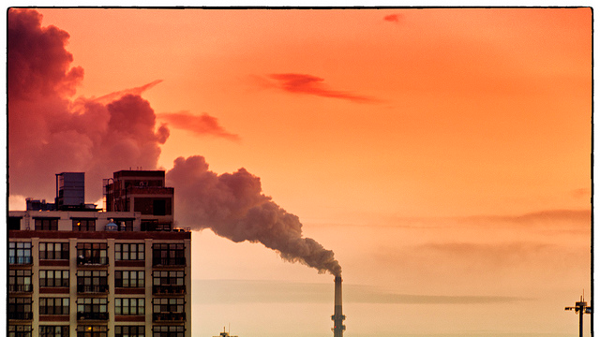
Title V Applicable (continued)
Affected Sources under Acid Rain Rules (est. under 1990 CAAA)
Reduction of SO₂ and NO_{x}
Permanent cap on SO₂ emissions from EGUs
In 2010, the cap was set to 8.95mil tons
NO_{x} reductions are based on a traditional, rate-based regulatory system
Notes:
Aimed towards the reduction of sulfur dioxide and nitrogen oxides.
Put a permanent cap on SO₂ emissions. A cap of 8.95 million tons which is ½ of the total SO₂ emissions produced by the power sector in 1980.

Slide 6
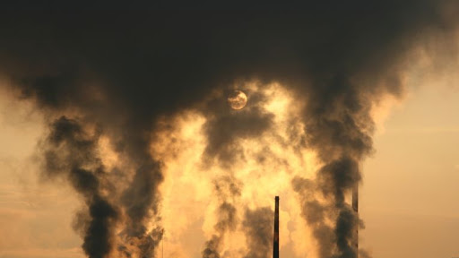
Title V Applicable (continued)
Solid Waste Incineration Units (under Section 129 of the CAA)
Regardless of size
Municipal waste combustion
Hospital/ medical/ infectious waste incinerators
Commercial and industrial solid waste incinerators
Other solid waste incinerators
Sewage sludge incinerators
Notes:
Municipal waste is non-hazardous waste

Slide 7
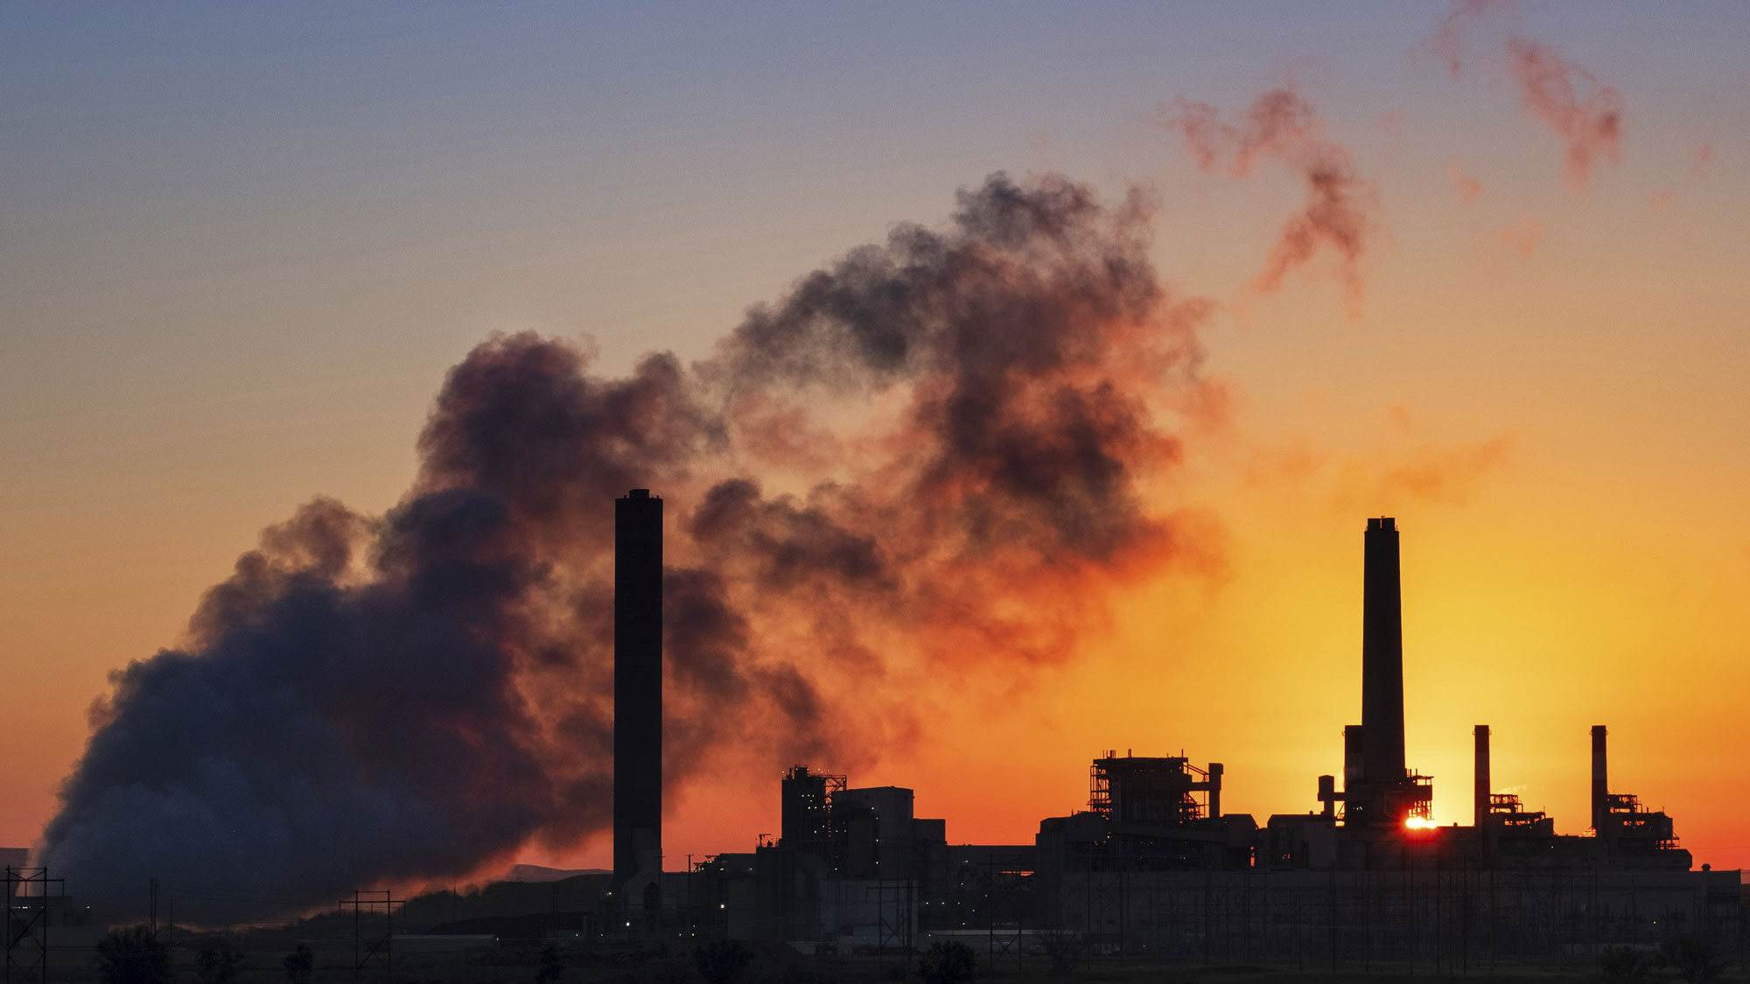
Title V Applicable (continued)
Non-Major Sources (subject to NESHAP)
E.g. : hazardous waste combustors, portland cement manufacturers, secondary lead smelters, glass manufacturing,...
Certain Synthetic Minor Sources
Chemical manufacturing (i.e. agricultural chemicals and pesticides, pharmaceutical, synthetic rubber manufacturing, etc.)
Notes:
National Emission Standards for Hazardous Air Pollutants (NESHAP)

Slide 8
Agency Coordination
State, local, & tribal agencies can process Title-I & Title-V (for minor sources)
In certain cases, the EPA will process permits out of one of its ten regional offices in place of the above agencies if it does not meet the program requirements under Part 70 of the CAA.
The EPA will process major-source permits

Slide 9
Necessary Information
Identifying information (company name and address)
Description of source’s processes and products
Emission related information (major source pollutants, emission rate(s), current control technology, etc.)
Applicable air pollution requirements
Applicable exemptions
Compliance plan
Nationally-standardized forms for the acid rain section of the permit
Notes:
Description of source’s processes and products (as defined by the Standard Industrial Classification Code)

Slide 10
Where can you get this information from?
In order to obtain the required information (or guidance), one can contact their state or local agency.
The appropriate agency will be able to handle the administrative procedures necessary to fulfill the requirements of the permit application.

Slide 11
Enforcement Penalties
If all permit application (or existing violation) fees have not been paid, then the permit will be suspended until the source’s fees have been paid (or compliance has been met).
For violations (as defined under the CAA), the EPA can assign financial penalties to the source in noncompliance at a value based up on (including, but not limited to) individual violations, source type, severity, or financial gain as a result of the violation(s).

Slide 12
Processing Times
The timeline to obtain a permit can depend upon the type of permit as well as the agency performing the evaluation.
Generally, large source = more federal involvement = longer processing times (upwards of one to two years).
Small source = local, state, tribal involvement (upwards of six months).
Even smaller, local, state, or tribal permits = even less processing time (a few weeks or less).

Slide 13
Definitions
Attainment Area - is an area that meets the NAAQS
Unclassifiable Area - is an area that does not have air quality data
Nonattainment Area - is an area that does not meet NAAQS (where additional measures must be taken to decrease air pollutants in order to meet attainment)

Slide 14
Regulations (CFR)
PART 70: STATE OPERATING PERMIT PROGRAMS
PART 71: FEDERAL OPERATING PERMIT PROGRAMS

Slide 15
Other Resources
Information: United States Environmental Protection Agency | US EPA
govinfo | US Government Publishing Office
DEC Home
Images:
Title Slide Image, Slide 2 Image, Slide 3 Image, Slide 4 Image, Slide 5 Image, Slide 6 Image, Slide 7 Image, Slide 8 Image, Slide 9 Image, Slide 10 Image, Slide 11 Image, Slide 12 Image, Slide 13 Image, Slide 16 Image

Slide 16
Any Questions?
Any Questions?
Any Questions?
Any Questions?
Any Questions?
Any Questions?

